Slide 1
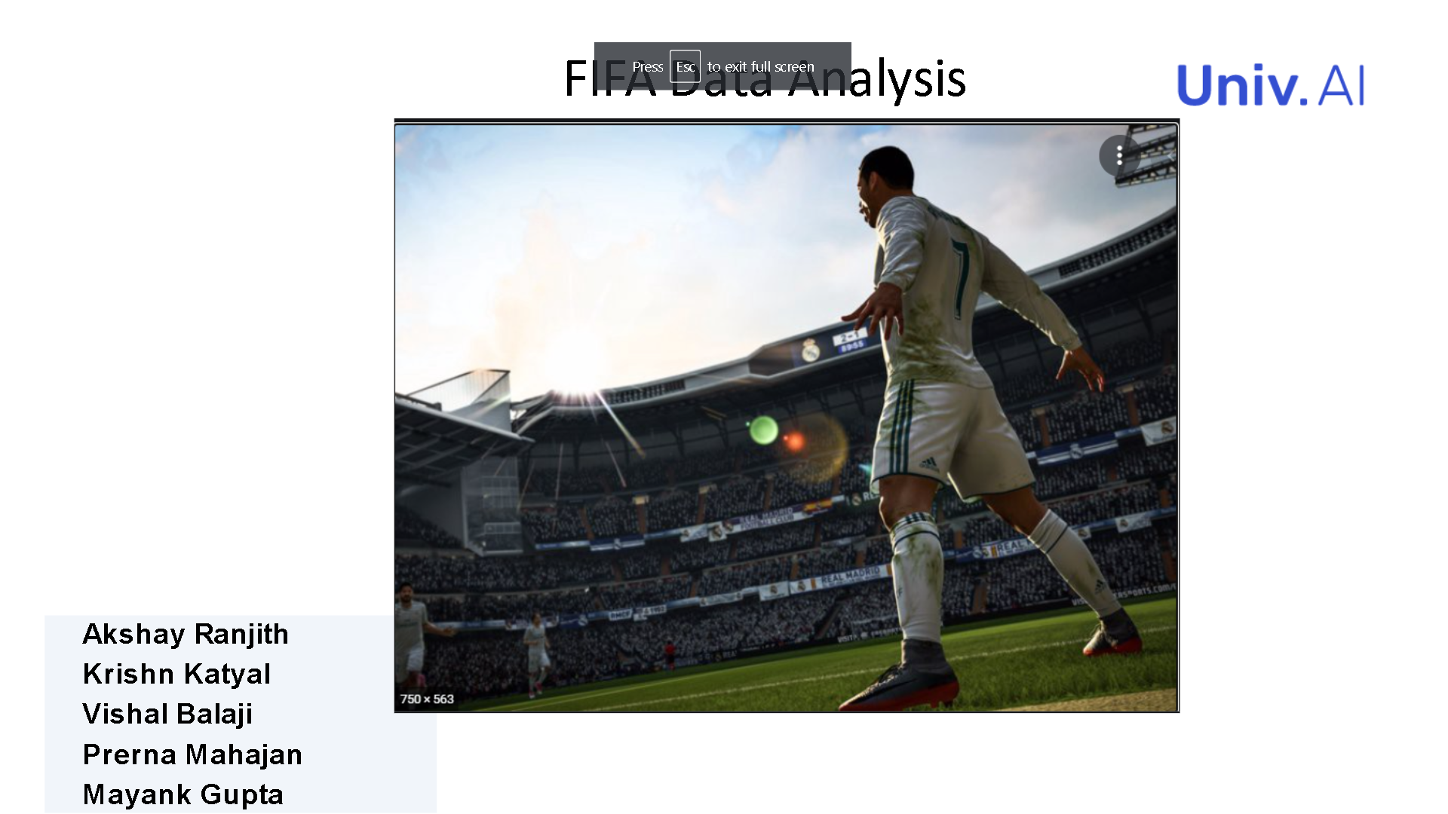



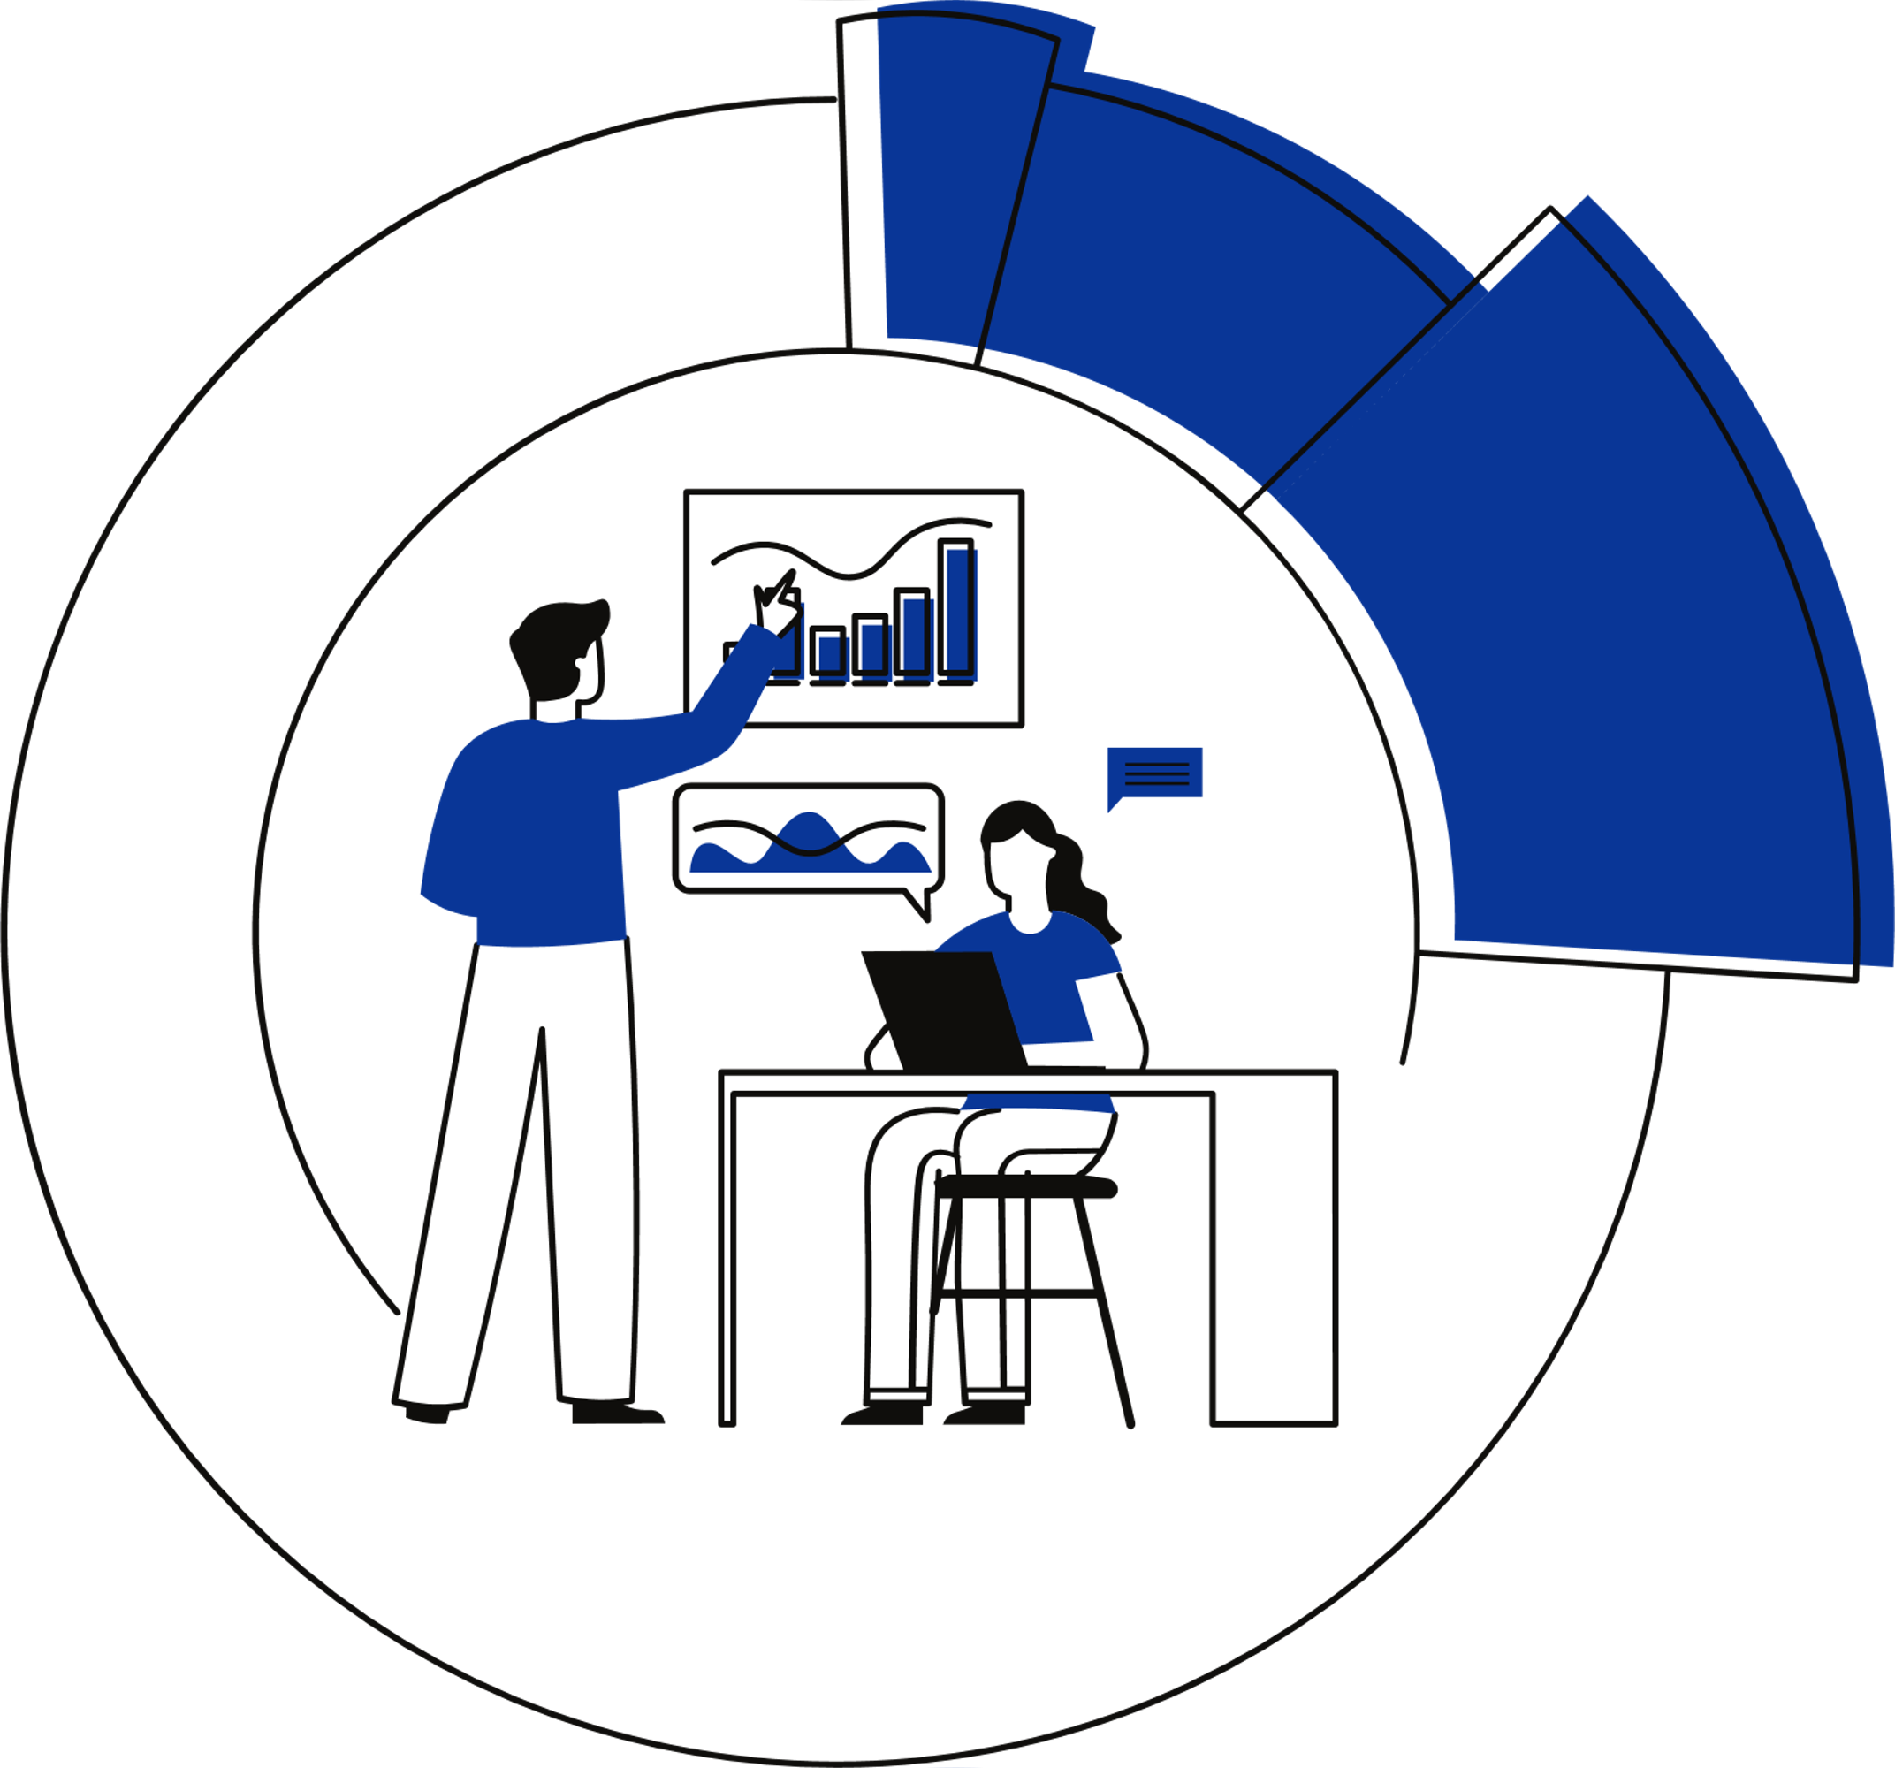

Fifa Data Analysis
Akshay Ranjith
Krishn Katyal
Vishal Balaji
Prerna Mahajan
Mayank Gupta

Slide 2


INTRODUCTION
How to analyse and process data to analyse players and team performance
APPROACH TO THE SOLUTION
Understand the data features and preprocess them and identify relationships and trends
DATA DESCRIPTION
What goes inside the model for training?
EDA
Understand the data better and pre-process the data accordingly
Table of Contents
MODELING
Training Different Models
INTERPRETATION
Interpreting model scores and performing feature importance
RESULTS & FUTURE WORK
Followed by gratitude and references

Slide 3
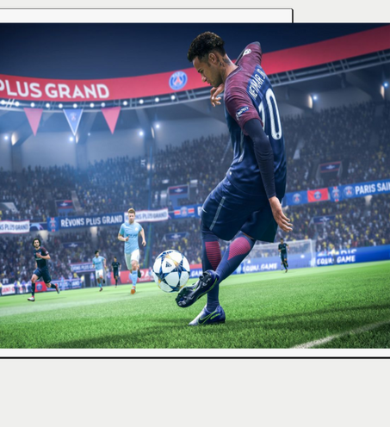

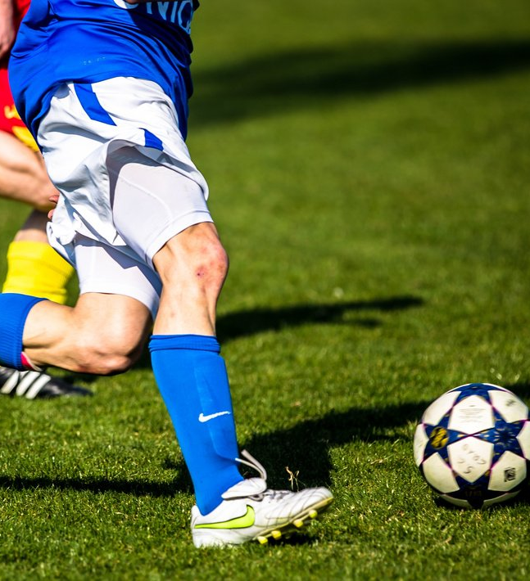
INTRODUCTION
FIFA Data Analysis
Use ML Models to rank players, classify players positions and identify the best club
The task is to use data to build a predictive model for the evaluation of a player’s /club value.
Process Features, use the feature transformation and experiment with different models to better understand the players and club performances across the years, as well as understand which features influence a player’s club value.

Slide 4
OUR APPROACH
RANK THE PLAYERS
CLASSIFY PLAYER POSITION
BEST CLUB
EDA
Data Preprocessing
Feature Selection
Training and Testing the Model
Data Preprocessing
Feature Transformation
Identification of appropriate metric for score comparisons
Feature Selection
Extracting Values and Calculating the overall score
Model Selection
Training and Testing the model
Evaluation and visualization

Slide 5
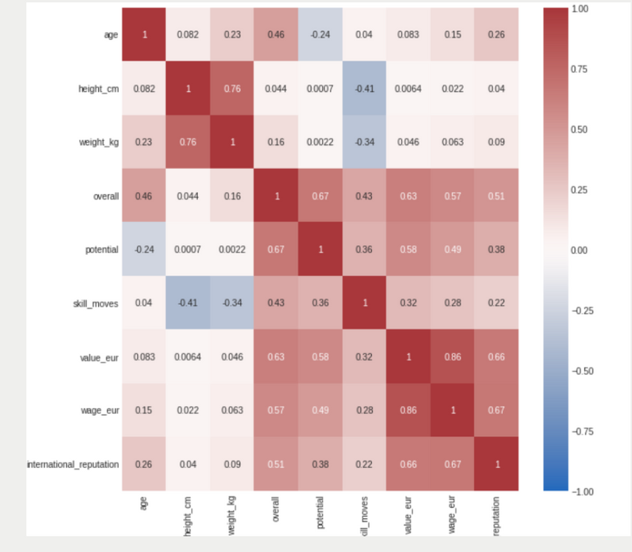
EDA AND DATA PRE-PROCESSING
We observed that our data has many categorical variables
We performed feature transformation, null values, feature scaling including one-hot encoding, multivalued features , dropped collinear features
For different tasks we identified response variables and transformed them
Correlation between player overall score and attributes

Slide 6
EDA AND DATA PRE-PROCESSING
Most of our columns contained outliers
We scaled the continuous columns to reduce the adverse effect of the outliers on boosting algorithms
We ordinally encoded the categorical columns
Histogram of random 8 out of 230 predictors of our training data

Slide 7
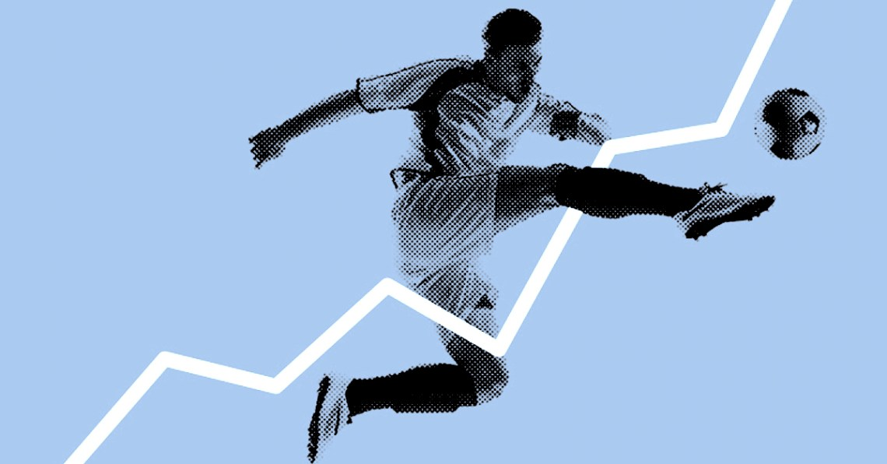

MODELLING

Slide 8
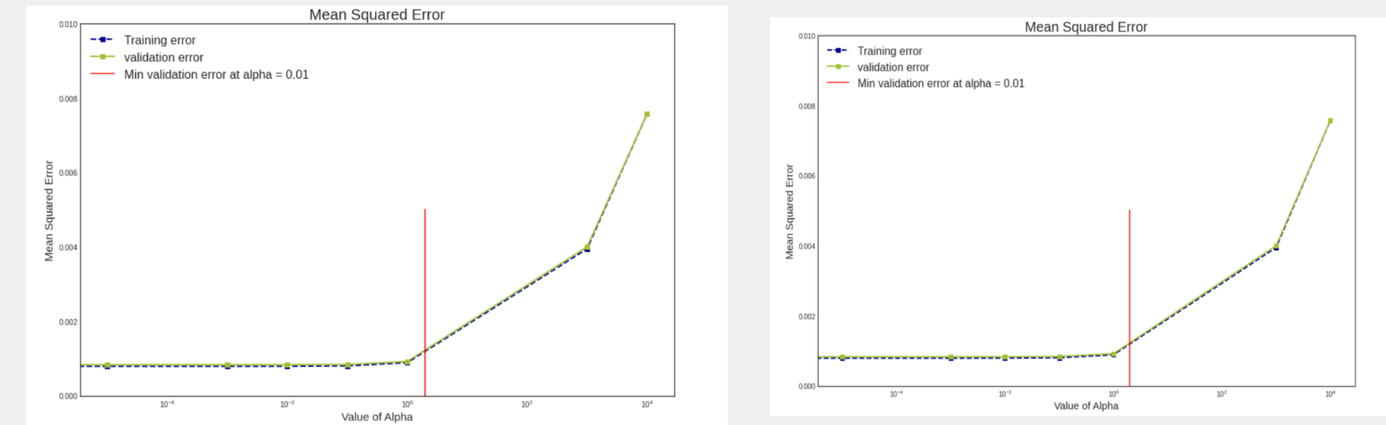
MODELLING PART-A

Slide 9
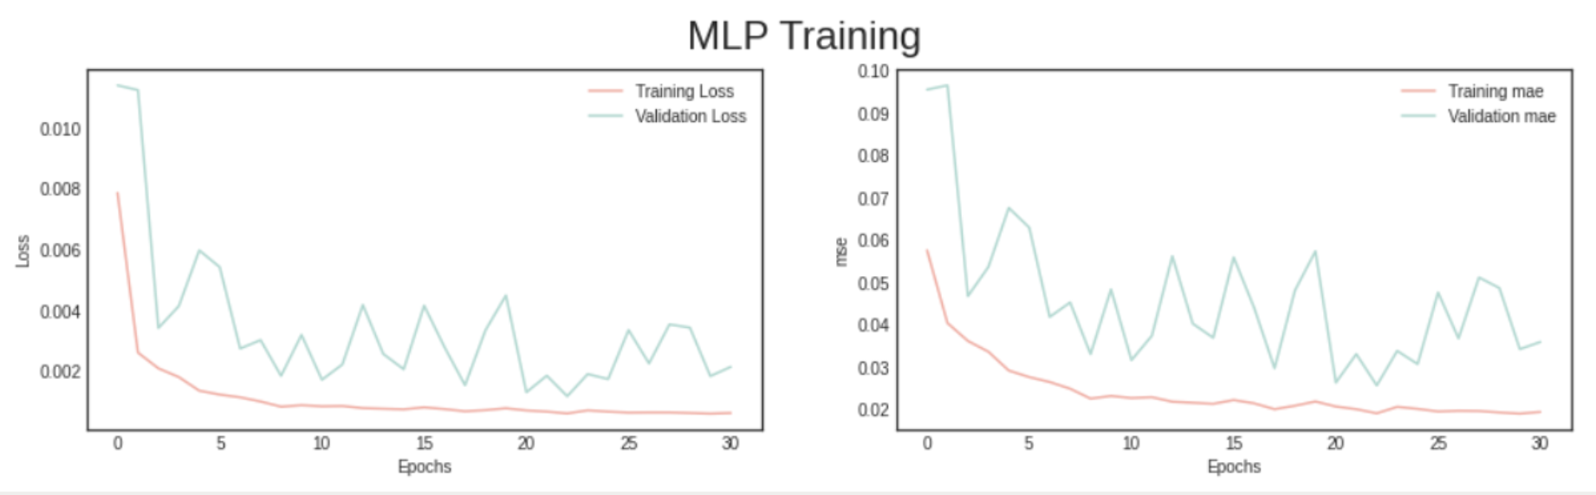
MODELLING PART-A

Slide 10
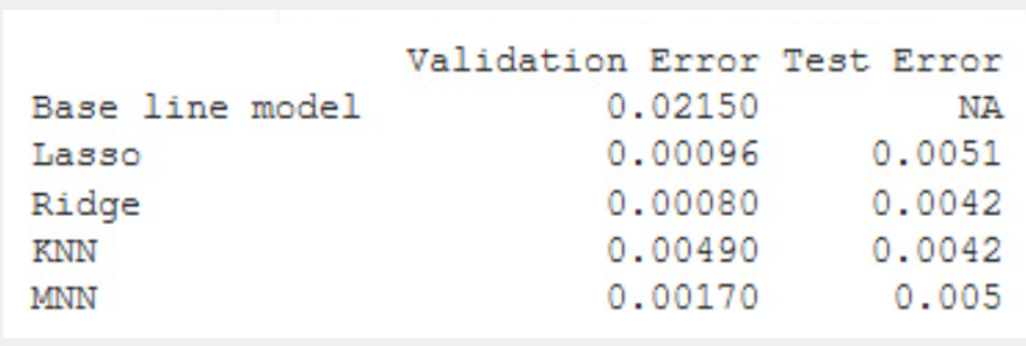
MODELLING - PART A
We experimented with 4
different models
Base Line Model
Lasso /Ridge Regression
K Nearest Neighbors
MultiLayer Neural Network
For all the above models we chose the best hyperparameter viz. K, max_features, learning_rate,C using GridSearchCV
We also performed Feature Selection

Slide 11
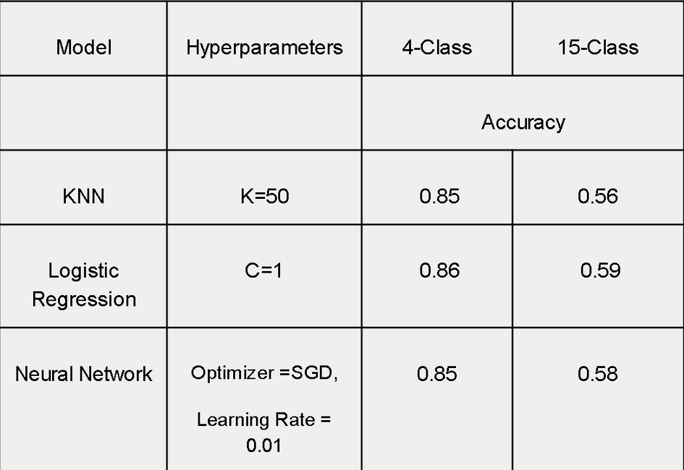
MODELLING - PART B
Classify player position
We experimented with 4
different models
Base Line Model
Lasso /Ridge Regression
K Nearest Neighbors
MultiLayer Neural Network
For all the above models we chose the best hyperparameter viz. K,, max_features, learning_rate, C using GridSearchCV
We also created two models with each different classifier using above estimators to get more robust results
Scoring metric - Accuracy score

Slide 12
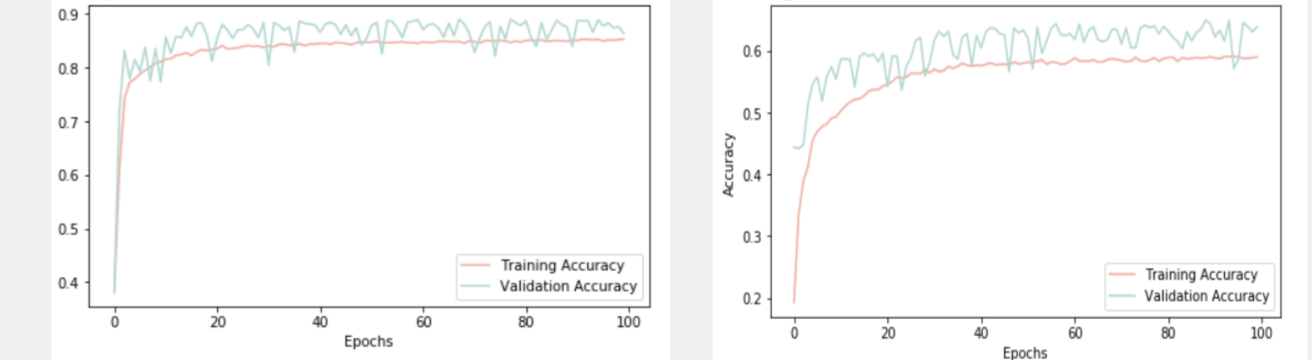
MODEL COMPARISON
Accuracy-0.85
Accuracy-0.60
We can clearly see that Neural Network with 4 Output Classes performed better than NN with 15-output Classes based on Accuracy Score(0.85). NN also outperform KNN and Logistic Regression.Also Random Forest gave competitive results. However for each model the response variable with 4-classes gave better performance

Slide 13
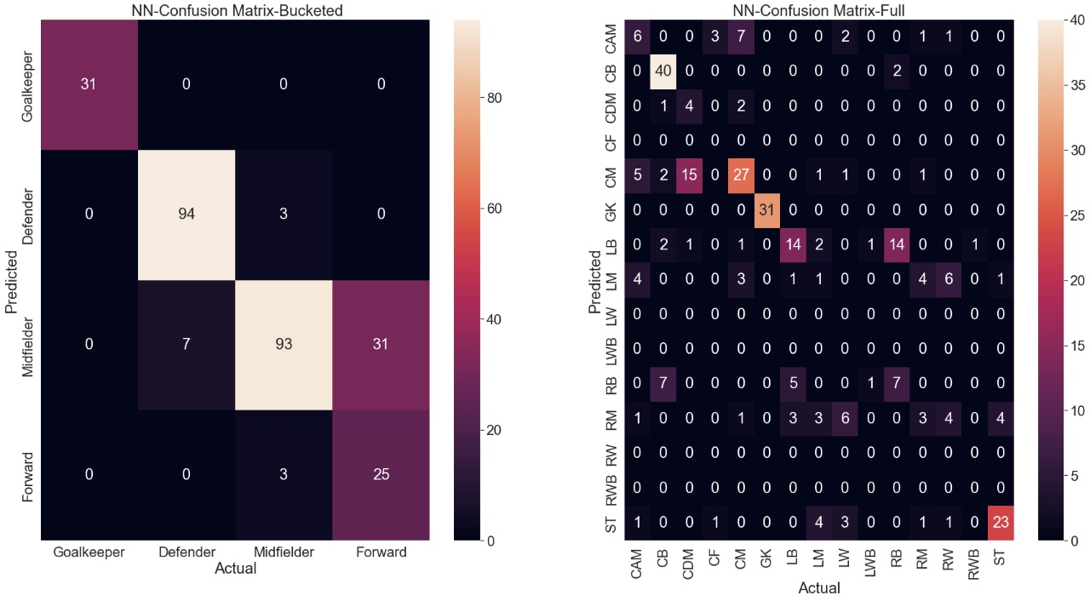
TEST RESULTS-NEURAL NETWORK
Accuracy-0.85
Accuracy-0.45

Slide 14
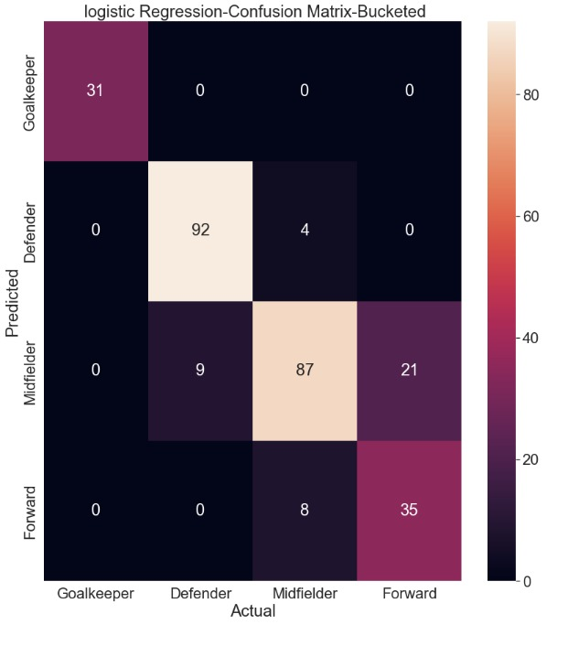

TEST RESULTS - LOGISTIC REGRESSION
Accuracy-0.82
Accuracy-0.48

Slide 15
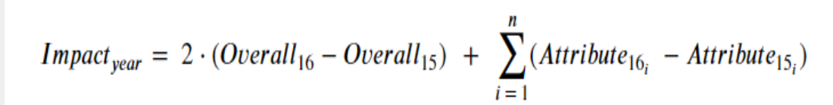
PART C -
Analyze Historical Data to Predict Best Staff Per Club
Score Calculation
Considerations:
Impose higher weightage on Overall to praise or punish an increase or decrease in Overall more than the others.
Impact value is calculated for each player for each year that they have played.
A team's score is Sum of all the Impact they have had summed over "player years" played

Slide 16
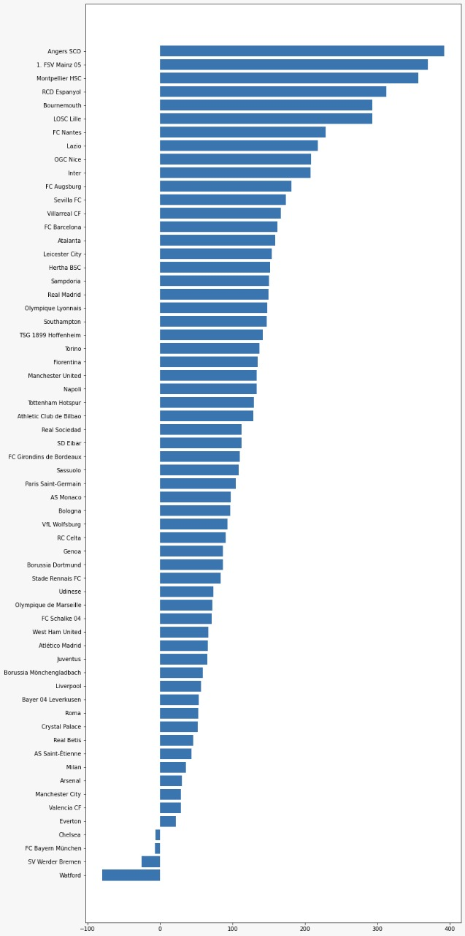
PART C -
Analyze Historical Data to Predict Best Staff Per Club

Slide 17
INFERENCES
FC Barcelona is the first by a huge margin, and almost all of this rides on the market value of Lionel Messi
There is an age penalty on performance. As age increases, performance either tapers or starts falling.
It looks like a lot of good teams are performing badly.

Slide 18
LEARNINGS AND FUTURE WORK
From EDA we realized that our data has a lot of outliers which severely de (??????)
We realized that OOB error isn’t completely reliable when dealing with imbalanced data
We got NN classifier as our best performing model, (????)
As a future work we can try and identify the (????)
We can create analytics application for predicting Players performance, Club Performance, predicting score and future valuation of players

Slide 19

Akshay Ranjith
Krishn Katyal
Vishal Balaji
Prerna Mahajan
Mayank Gupta

